Slide 1
Chapter 13:
The Graph Abstract Data Type
Data Structures in Java: From Abstract Data Types to the Java Collections Framework
by Simon Gray

Slide 2
Graph Terminology
A graph G = (V, E) is an ordered pair of finite sets V and E, where V(G) is the set of vertices in G, and E(G) is the set of edges in G. The edge connecting vertices v_{i} and v_{j} is represented as (v_{i} , v_{j}). The number of vertices in G is given as |V| and the number of edges in G is given as |E|.

Slide 3
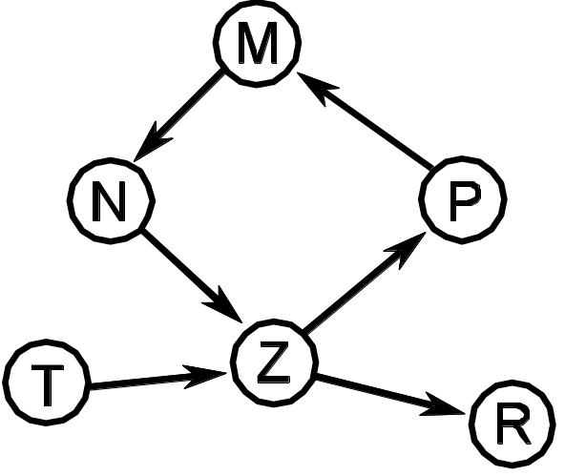
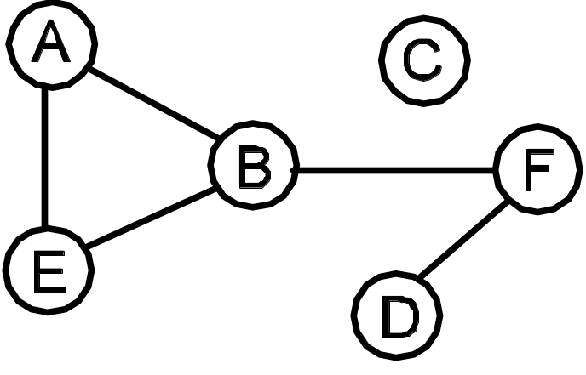
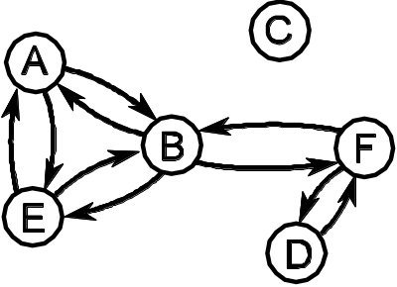
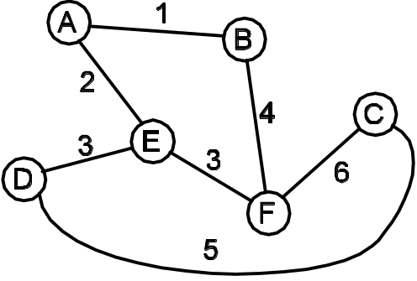
Sample Graphs: undirected, directed, & weighted.
(a) Graph G1 – an undirected graph.
(b) Graph G2—a directed graph.
(c) Graph G3 – a directed version
of graph G1.
(d) Graph G4 – an undirected graph
with weighted edges.

Slide 4
Graph Terminology
adjacency of vertices
in-degree & out-degree
weighted edges
path, simple path & cycle
connected & reachable
connected graph
complete graph
subgraph

Slide 5
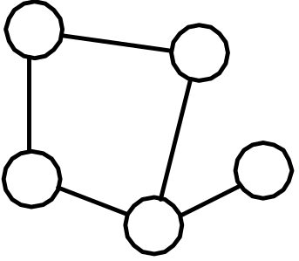
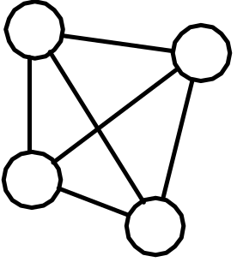
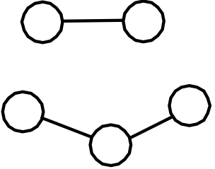
Connected and Complete Graphs
(a) A connected graph. | (b) A disconnected graph. | (b) A complete graph.

Slide 6
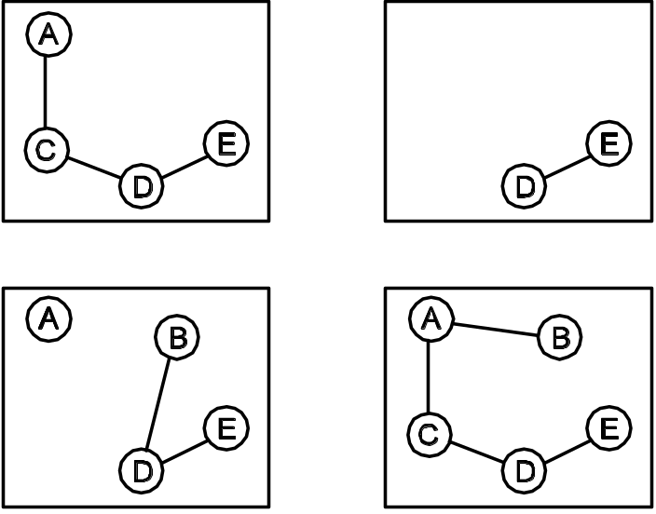
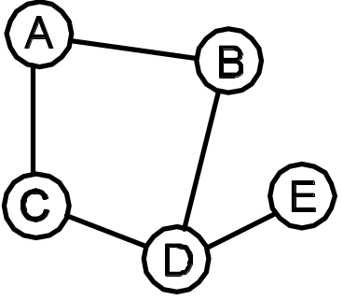
Subgraphs
(a) Graph G₅. |  | (b) Some subgraphs of G₅.

Slide 7
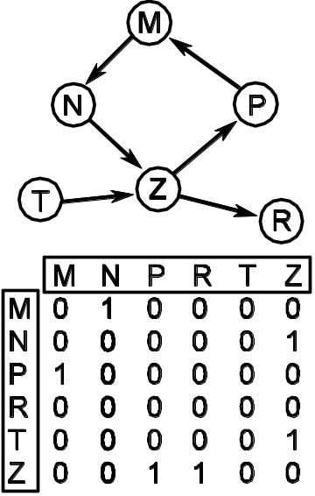
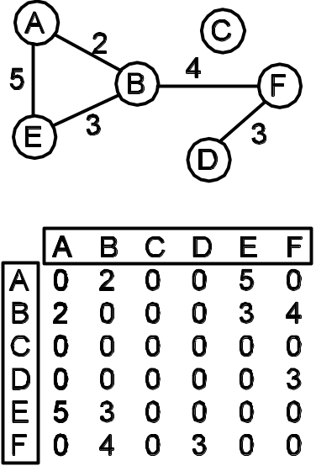
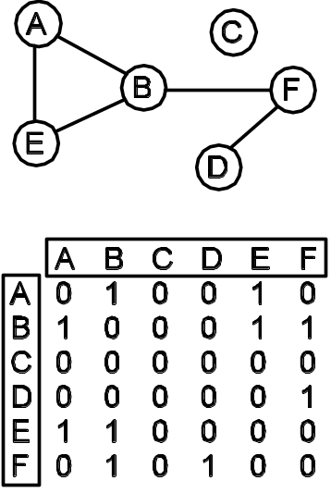
Adjacency Matrix Representation
(a) Adjacency matrix for an undirected graph. | (b) Adjacency matrix for a directed graph. | (c) Adjacency matrix for an undirected weighted graph.

Slide 8
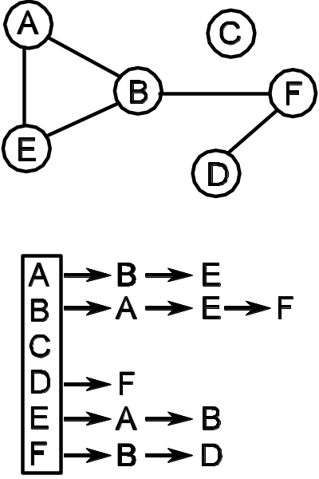
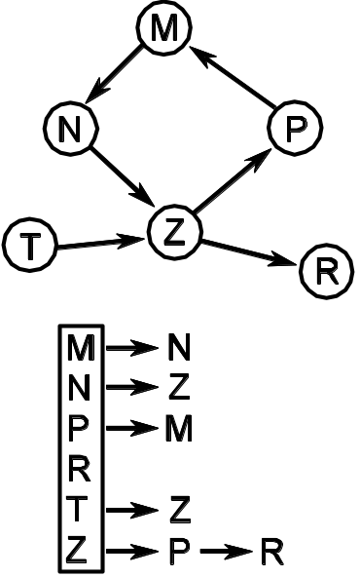
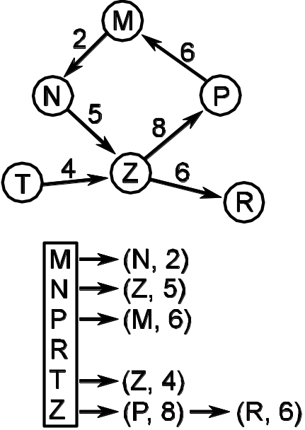
Adjacency List Representation
(a) Adjacency list for an undirected graph. | (b) Adjacency list for a directed graph. | (c) Adjacency list for a directed weighted graph.

Slide 9
Depth First Search
// Perform a depth first search of a Graph g
// originating from Vertex v
Pseudocode DFS ( Graph g, Vertex v )
1. mark v as visited // visit a vertex only once!
2. for each Vertex w adjacent to v
3. if w has not been visited
4. DFS( w )

Slide 10
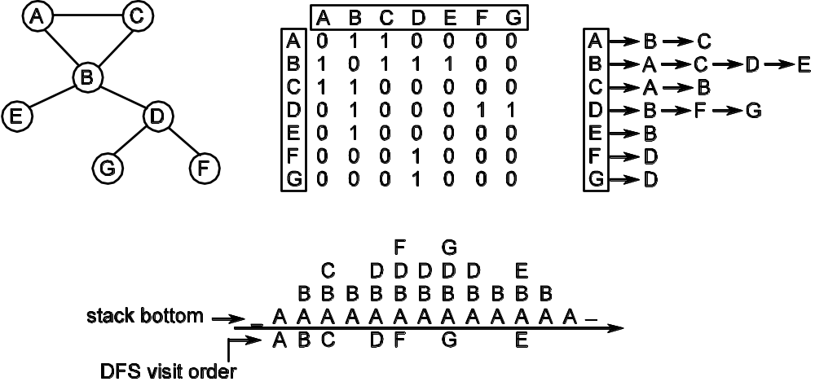
Depth First Search Example

Slide 11
Breadth First Search
// Perform a breadth first search of a Graph g
// originating from Vertex v
Pseudocode BFS ( Graph g, Vertex v )
vertexQueue – a Queue of Vertices
1. mark v as visited
2. enqueue v in vertexQueue
3. while vertexQueue is not empty
4. let v be the element removed from the front of vertexQueue
5. for all Vertices w adjacent to v
6. if w has not been visited
7. enqueue w in vertexQueue
8. mark w as visited

Slide 12
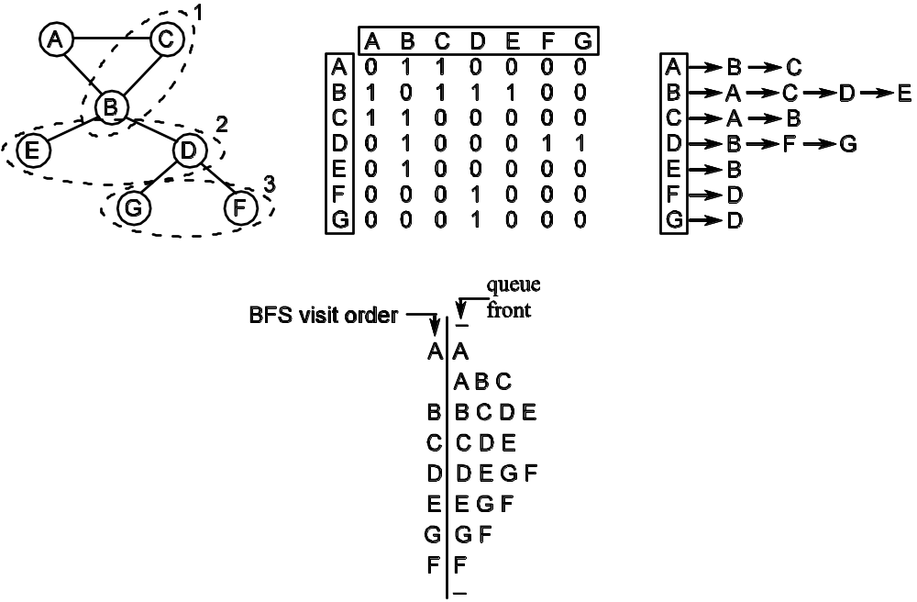
Breadth First Search Example

Slide 13
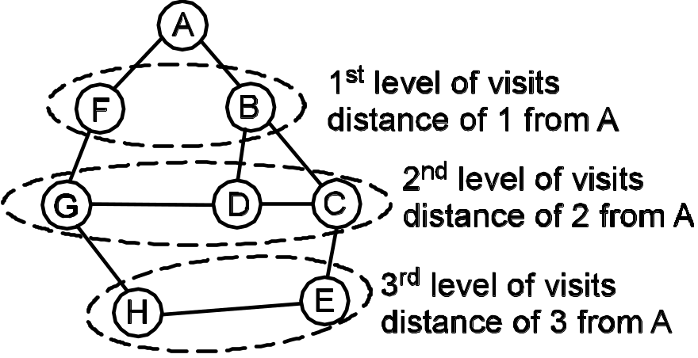
Shortest Path Algorithm
List shortestPath( Graph g, Vertex src, Vertex dest )
// Find a shortest path from src to dest in Graph g. Return an empty
// List if no path
// exists, or the vertices in the path from src to dest otherwise.
If all edges have the same
weight, then BFS will find
shortest path.

Slide 14
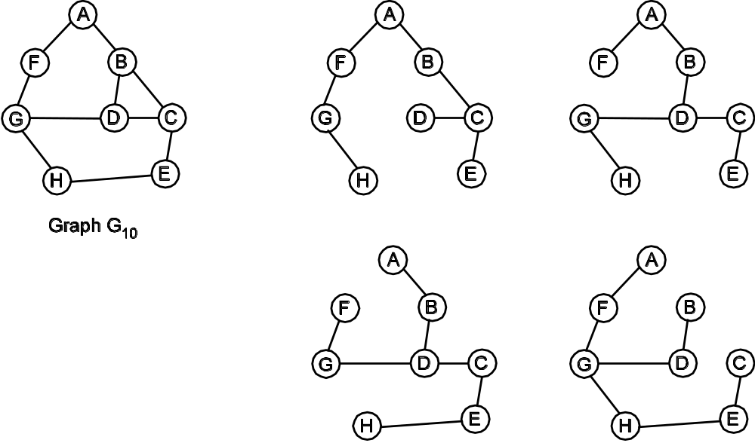
Spanning Tree Algorithm
A spanning tree of a graph G is a connected acyclic subgraph, G′,
containing all the vertices of G; that is, G′( V) = G(V).
Graph spanningTree( Graph g, Vertex src )
// Return a spanning tree of g using src as the root of the tree.
// If the returned
// graph is empty, g is not connected.
DFS will visit each of the
vertices in the graph once;
keep track of the vertices
and edges connecting them
to identify a spanning tree.

Slide 15
Minimal Path Algorithm
// Return the cost of a minimal cost path in
// Graph g from Vertex src to dest
Pseudocode Minimal Path( Graph g, Vertex src, Vertex dest )
priorityQueue – a priority queue holding ⟨Vertex , minCostToVertex⟩ pairs
verticesInSomePathToDest – a collection of vertices in some possible path from src to dest
1. place ⟨src, 0⟩ in priorityQueue
2. while priorityQueue is not empty
// get the least expensive path seen so far
3. pair = the ⟨vertex, minCostToVertex ⟩ pair removed from priorityQueue
4. v = pair.vertex // extract the vertex field from pair
5. minCostToV = pair. minCostToVertex // extract the cost field from pair
6. if v == dest
7. return minCostToV // success; return cost from src to v
// haven’t found the target yet, so continue the search
8. add v to verticesInSomePathToDest
9. for each Vertex w adjacent to v
10. if w is not in verticesInSomePathToDest // avoid revisiting a visited vertex
11. let minCostToW be minCostToV + weight(v, w) // get total cost from src to w
12. add the pair ⟨w, minCostToW⟩ to priorityQueue
13. return failure // there is no path from src to dest

Slide 16
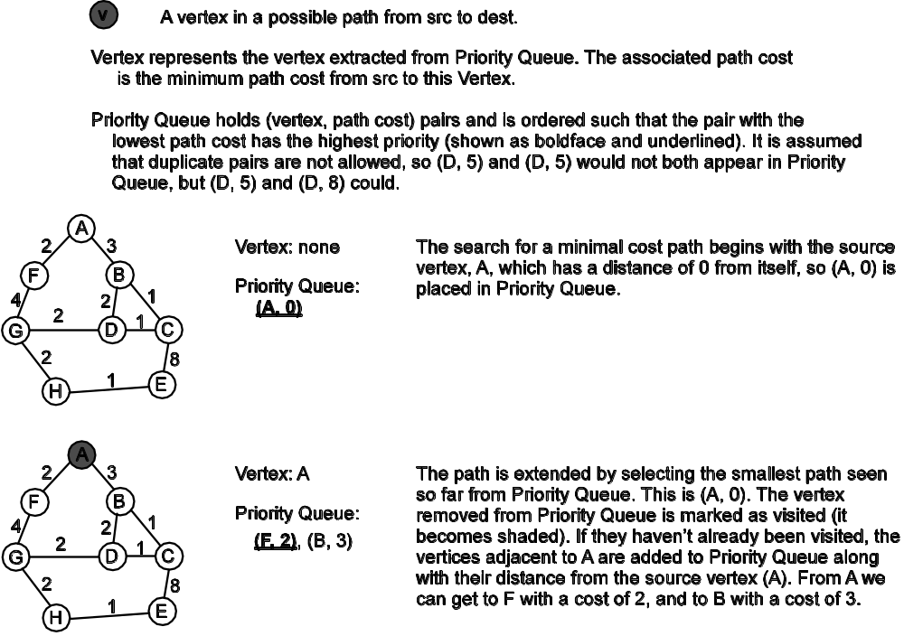
Minimal Path Algorithm Example (1)
Searching for a path from A to E

Slide 17
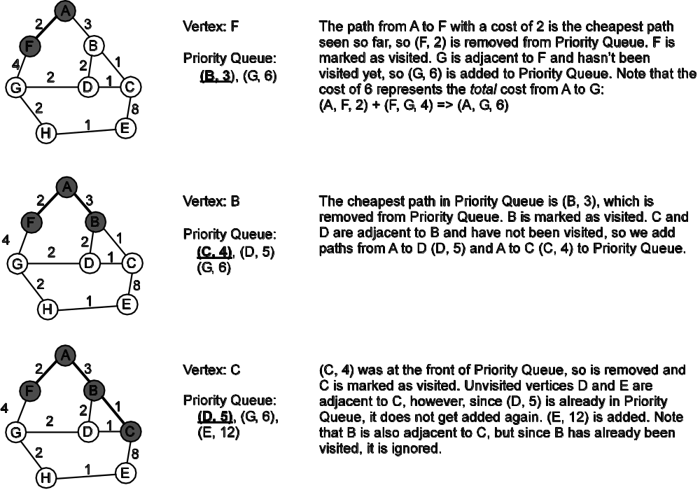
Minimal Path Algorithm Example (2)

Slide 18
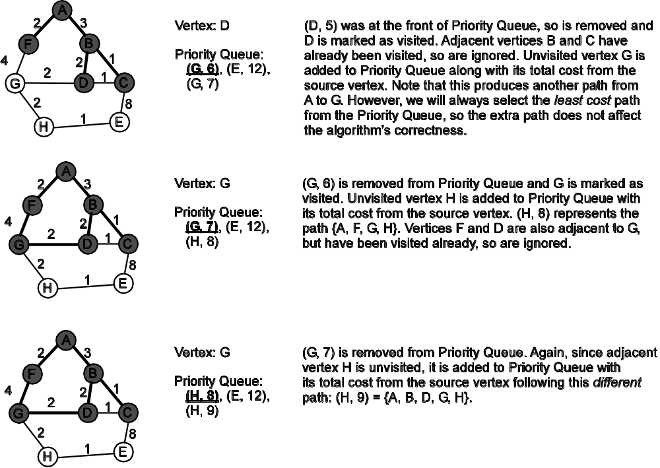
Minimal Path Algorithm Example (3)

Slide 19
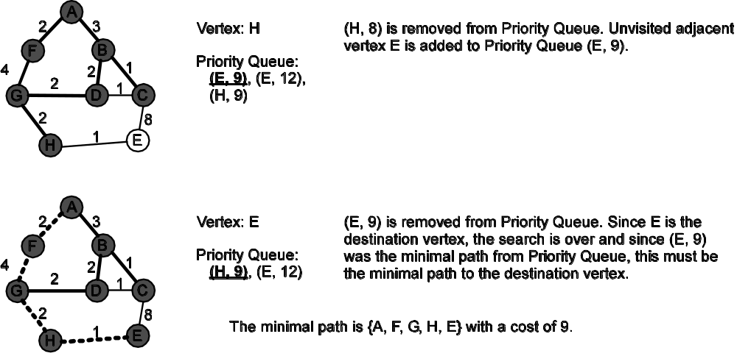
Minimal Path Algorithm Example (4)

Slide 20
Minimal Spanning Tree Algorithm
// Identify a Minimal Spanning Tree for a weighted Graph g with Vertex v as its root.
Pseudocode minimalSpanningTree ( Graph g, Vertex v )
MST – a collection of edges (v, w) in the Minimal Spanning Tree; initially this collection is empty
mstCost – the total cost of all edges in MST; initially 0
visitedVertices – a collection of all vertices that are in MST; initially this collection stores
a vertex from G that will be the root of the MST
1. allVerticesVisited = false
2. put the starting vertex v in visitedVertices
// while the MST is not complete and there are vertices to visit
3. while MST.size() < |V| - 1 and not allVerticesVisited
// select the least cost candidate edge
4. get the least cost edge (v, w) such that v is in visitedVertices
5. and w is not in visitedVertices
6. if no such edge exists then
7. allVerticesVisited is true
8. else
9. add (v, w) to MST
10. add the cost of edge (v, w) to mstCost
11. add w to visitedVertices
// loop invariant: MST contains the edges of a minimal spanning
// tree for all vertices from G that are in visitedVertices
12. if MST.size() != |V| - 1 then
13. return failure
14. return MST // success

Slide 21
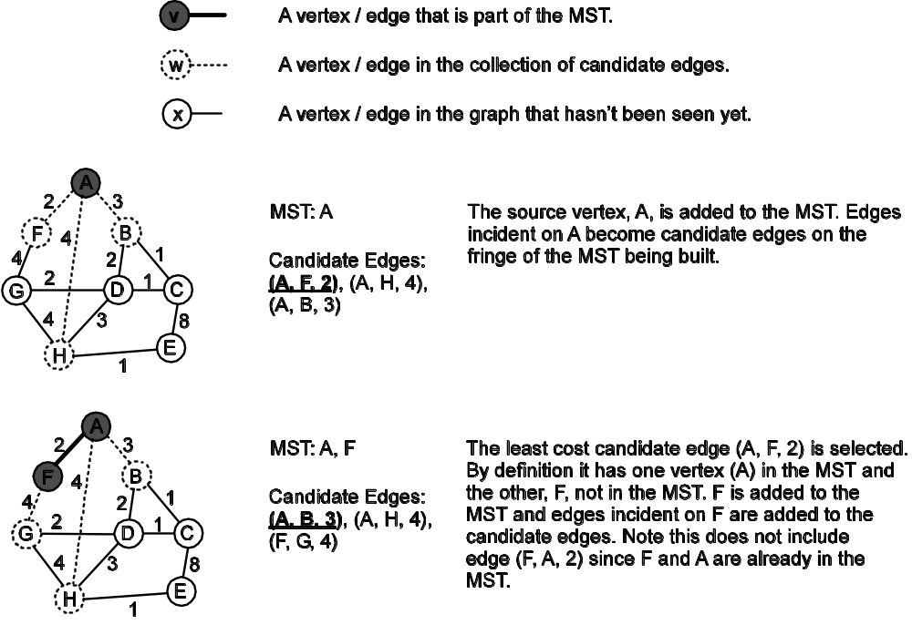
Minimal Spanning Tree Example (1)

Slide 22
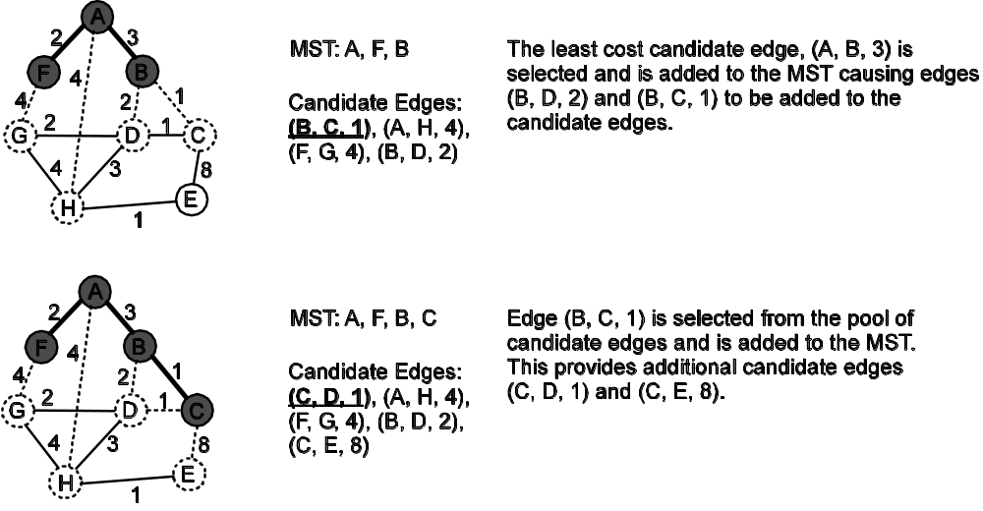
Minimal Spanning Tree Example (2)

Slide 23
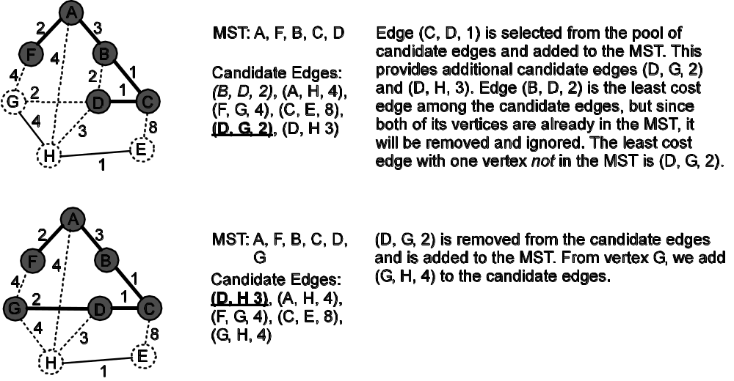
Minimal Spanning Tree Example (3)

Slide 24
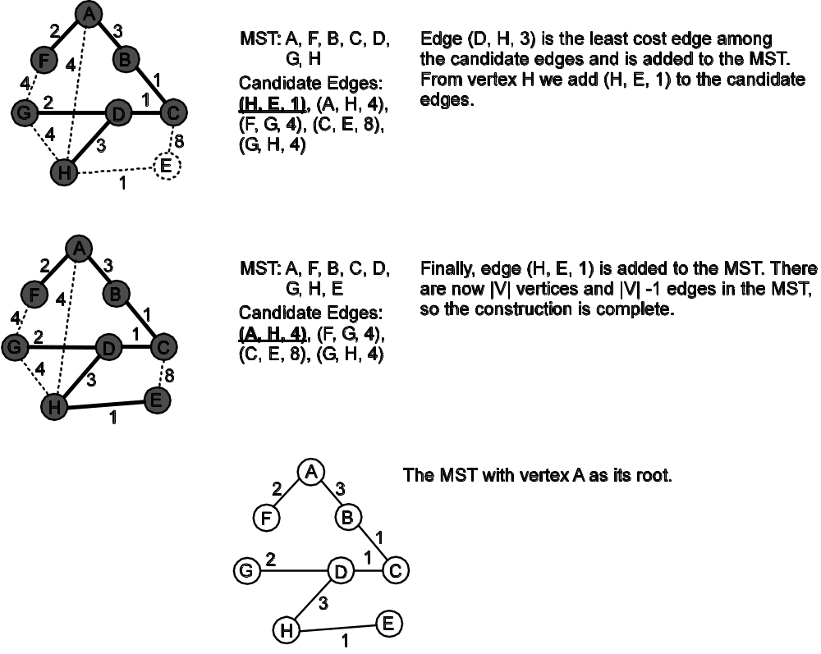
Minimal Spanning Tree Example (4)

Slide 25
The Graph ADTs
What needs to be explicitly represented in a graph? Do we need a type to represent vertices? What about edges?
Our solution: explicitly represent vertices and implicitly represent edges via the vertices they connect
Graph ADT 13.1 specifies an unweighted graph that could be directed or undirected
Weighted Graph ADT 13.2 is as an extension of the Graph ADT. The only significant difference is the addition of operations to support edge weights
This design decision will be reflected in the implementation

Slide 26
The Graph Implementation
Let the Graph interface reflect the Graph ADT
Questions:
  Can a directed graph class and an undirected graph class be directly related?
  Should a digraph be a subclass of an undirected graph class, or vice versa?
  How do weighted graphs affect this design?

Slide 27
The Graph Implementation
How to handle the addition and deletion of edges?
The addEdge(v1, v2) operation will produce an edge from v1 to v2 in a directed graph, and an edge from v2 to v1 in an undirected graph
AdjMatrixDiGraph will implement the Graph interface for directed graphs using an adjacency matrix to store the graph
To represent undirected graphs, AdjMatrixGraph will be a subclass of AdjMatrixDiGraph. When dealing with edges, its methods will invoke their superclass (directed graph) counterparts, and then will handle the bidirectionality of an undirected graph locally

Slide 28
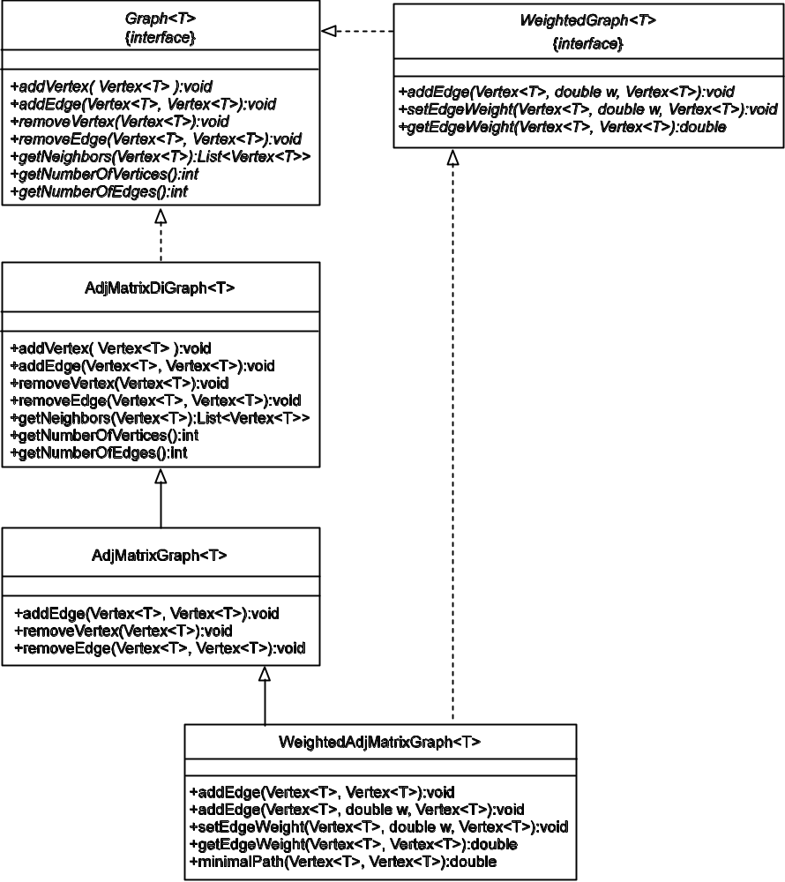
The Graph Hierarchy
The methods shown in a concrete class are either implemented in that class or are overridden there to provide a specialization of the method’s behavior.

Slide 29
AdjMatrixDiGraph
package gray.adts.graph;
import java.util.*;
/**
* An implementation of the <tt>Graph</tt> interface for a
* directed graph using an adjacency matrix to indicate the
* presence/absence of edges connecting vertices in the graph.
*/
public class AdjMatrixDiGraph<T> implements Graph<T> {
protected int numberOfVertices;
protected int numberOfEdges;
protected int[][] adjMatrix;
protected Vertex<T>[] vertices;
protected int v1Pos, v2Pos;
protected static int SIZE = 10;
Note the use of
protected here so
subclasses can have
direct access.

Slide 30
Method addEdge() // directed graph!
public void addEdge( Vertex<T> v1, Vertex<T> v2 ) {
v1Pos = getVerticesIndexFor( v1 );
v2Pos = getVerticesIndexFor( v2 );
if ( v1Pos == -1 || v2Pos == -1 ) {
throw new IllegalArgumentException( "vertex not found" );
}
// avoid adding duplicate edges
if ( this.adjMatrix[v1Pos][v2Pos] == 0 ) {
this.adjMatrix[v1Pos][v2Pos] = 1;
this.numberOfEdges++;
}
else {
throw new IllegalArgumentException( "duplicate edge "
+ v1 + " " + v2 );
}
}

Slide 31
Method addEdge() // undirected graph!
/**
* Adjacency Matrix implementation of an undirected
* Graph.
*/
public class AdjMatrixGraph<T>
extends AdjMatrixDiGraph<T> {
public AdjMatrixGraph() {
super();
}
public void addEdge( Vertex<T> v1, Vertex<T> v2 ) {
super.addEdge( v1, v2 );
// if we get here, the superclass method completed
// successfully and we can set edge from v2 to v1
this.adjMatrix[v2Pos][v1Pos] = 1;
}
let superclass create the edge from v1 to v2
now create the
v2 to v1 edge

Slide 32
WeightedAdjMatrixGraph
/**
* A weighted, undirected graph stored in an adjacency
* matrix. The weights must be >= 0.
*/
public class WeightedAdjMatrixGraph<T> extends
AdjMatrixGraph<T> implements WeightedGraph<T> {
/**
* The default weight for an edge in a weighted graph.
*/
public double DEFAULT_WEIGHT = 1.0;
/**
* Store weight edges. The adjacency matrix storing
* edges is in an ancestor class.
*/
protected double[][] weights;

Slide 33
addEdge() // weighted undirected graph!
public void addEdge( Vertex<T> v1, double weight,
Vertex<T> v2 ) {
if ( weight < 0.0 ) {
throw new IllegalArgumentException( "Edge weight " +
" must be >= 0.0" );
}
super.addEdge( v1, v2 );
// if we get here, method in superclass didn't throw
// an exception and method preconditions are met
this.setEdgeWeight( v1, weight, v2 );
}

Slide 34
overridden addEdge()
Overridden addEdge() inherited from AdjMatrixGraph.
Need to provide a weight for the edge; use the default value.
public void addEdge( Vertex<T> v1,
Vertex<T> v2 )
{
this.addEdge( v1, DEFAULT_WEIGHT, v2 );
}
More code reuse: Use the addEdge() from the
previous slide and just supply a DEFAULT_WEIGHT.

